Slide 1
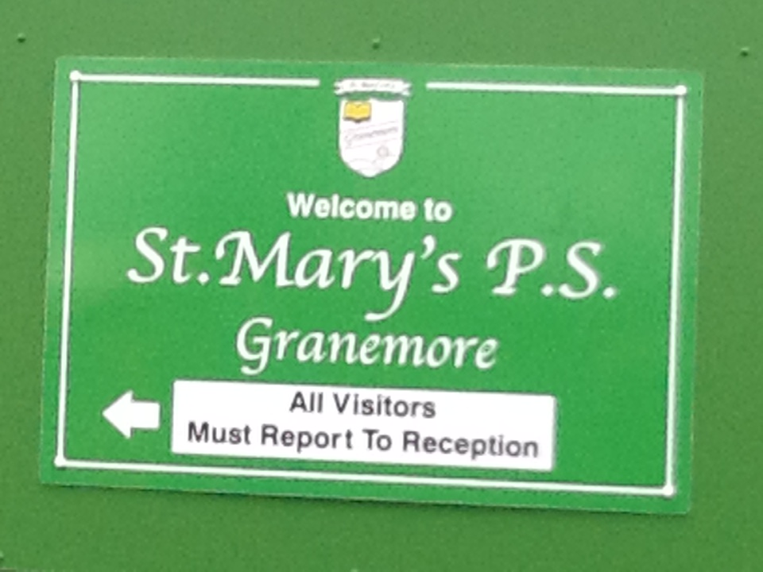
Changes to Granemore school

Slide 4
Before

Slide 5
Mobiles Moving

Slide 6
After

Slide 7
Facts
Question: How old do you think the school is?
Answer: It is 50 years old!
Question: How many people do you think the school holds?
Answer: It holds surprisingly about 200 pupils!

Slide 8
THANKS FOR WATCHING
BY JACK AND DARRAGH
BYE!LOL

